Slide 1
Simple Network Management Protocol (SNMP)
Shobnom Mushtary
Lecturer, CSE
Dhaka International University (DIU)

Slide 2
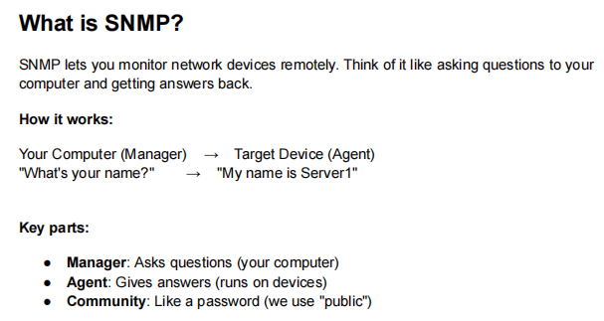

Slide 3
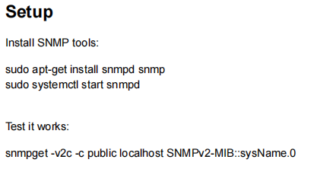

Slide 4
If the codes do not work or showing any error, then follow the following steps:
Install SNMP
  sudo apt update
  sudo apt install snmp snmpd
Check
  snmpd --version
Now MIB install and setup
sudo nano /etc/snmp/snmp.conf [a new page will open]
  Check if there exist –>
    mibs :
    Then comment it out using # - >
      #mibs :
    Then Press CTRL+O (Save) -> ENTER (confirm) -> CTRL+X (exit)
Restart the terminal -> source ~/.bashrc
Test SNMP
    snmpget -v2c -c public localhost SNMPv2-MIB::sysName.0

Slide 5
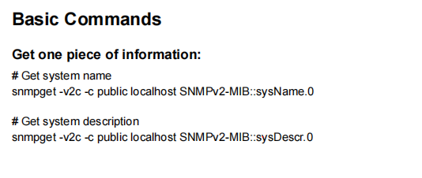
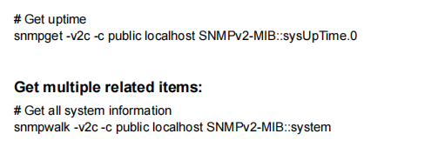
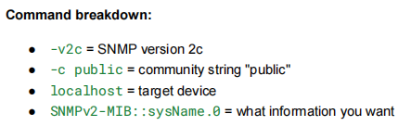
Device Name
OS + hardware + system info
How long has it been without a system restart?

Slide 6
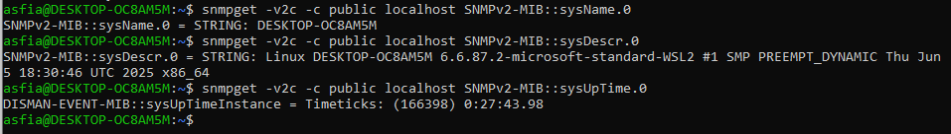

Slide 7

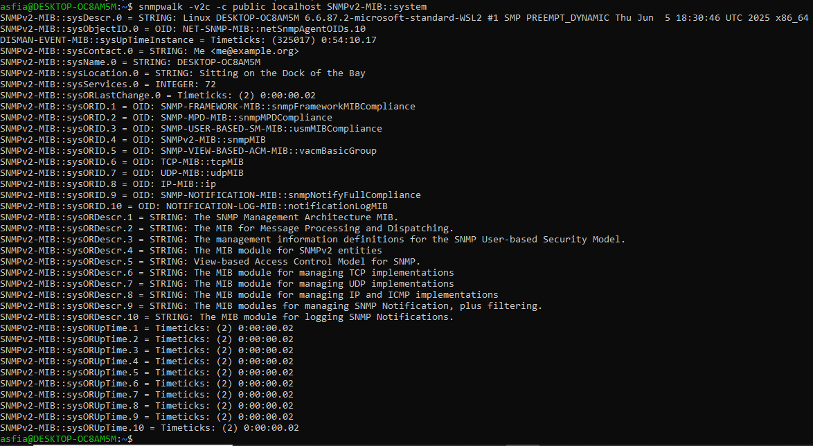

Slide 8
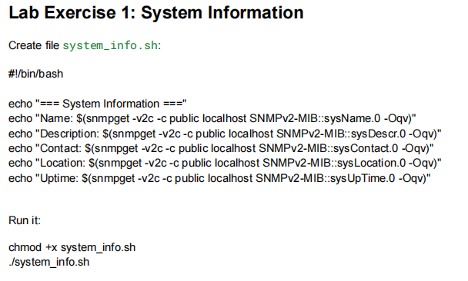
nano system_info.sh

Slide 9
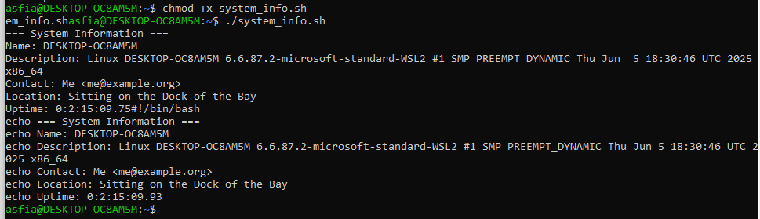
What this exercise does:
We create a shell script named system_info.sh
The script collects basic system information using SNMP commands
It displays information like system name, description, contact, location, and uptime
Why we do this:
To learn how SNMP can be used to monitor systems
To understand how to fetch specific data fields using MIB objects
To practice automation using a shell script

Slide 10

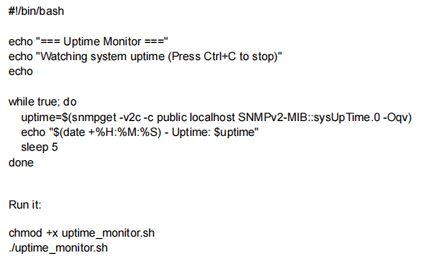

Slide 11
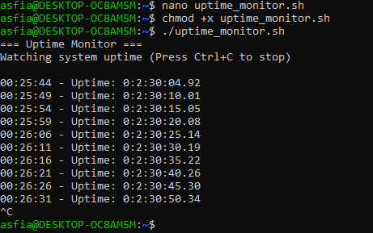
What the exercise does?
Continuously checks the system’s uptime using SNMP
Prints the current time and uptime every 5 seconds
Lets us monitor uptime changes in real-time
Why we do this exercise (Purpose)?
1. Real-time Monitoring: We learn how SNMP can be used for continuous monitoring instead of just single queries.
2. Detecting Restarts : If uptime resets to a smaller value, we know the system was rebooted.
3. Automation: The script runs automatically every 5 seconds without manual work.
4. Practical Networking Skill : Network monitoring tools (Zabbix, Nagios, LibreNMS) do the same thing — this gives basic understanding.

Slide 12
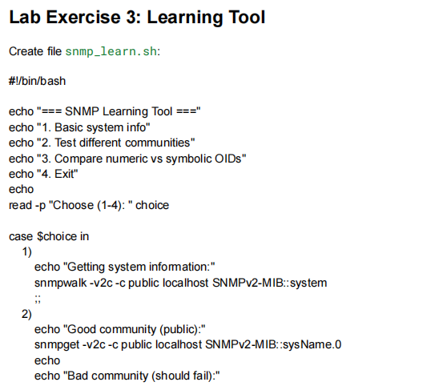
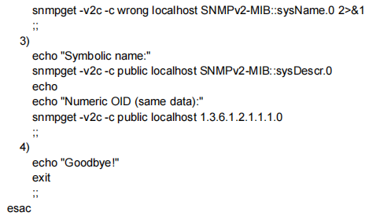


Slide 13
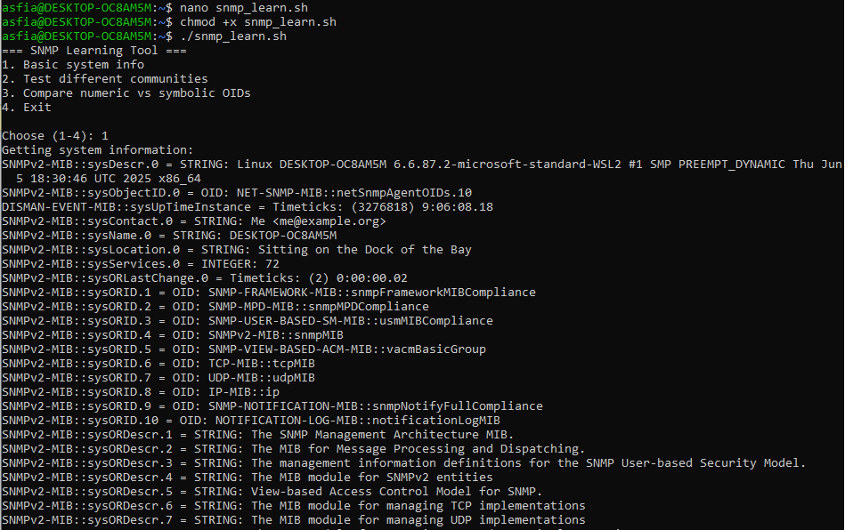

Slide 14
THANK YOU

